Slide 1
Assignment-based Subjective Questions

Slide 2
From your analysis of the categorical variables from the dataset, what could you infer about their effect on the dependent variable?
Ans. Rentals of bike in increasing order is as follows
-Fall (most) , summer , winter , spring (least)
More bikes have been rented in the year 2019 compared to 2018
September is the month with most bike rentals , least being in Jan/Dec
Rentals are more when skies are clear , followed by misty clouds
Why is it important to use drop_first=True during dummy variable creation?
Ans. We use drop_first to reduce an extra column when dummy variables are created , thus reducing the correlation created among other dummy variables.

Slide 3
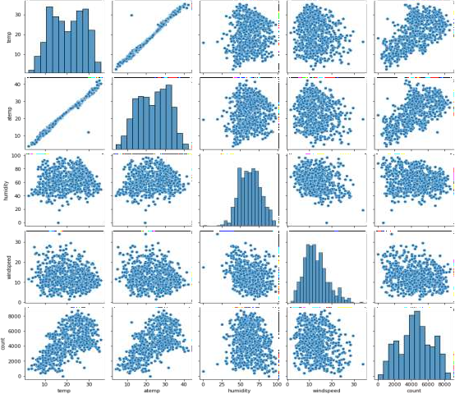
3. Looking at the pair-plot among the numerical variables, which one has the highest correlation with the target variable?
Ans. Temperature along with atemp seems to have a high correlation with count

Slide 4
4. How did you validate the assumptions of Linear Regression after building the model on the training set?
Ans. -Checking if the dependent variable and independent variable have a linear relationship
-Checking for no autocorrelation in residuals
-No heteroskedasticity
-No multicollinearity
-Residual errors are normally distributed
5. Based on the final model, which are the top 3 features contributing significantly towards explaining the demand of the shared bikes?
Ans. 1.Temperature ,
2.year and
3.light snow/rain -------------followed closely by winter season

Slide 5
General Subjective Questions

Slide 6
1. Explain the linear regression algorithm in detail
Ans. linear regression is a statistical regression method used for predictive analysis and show the relationship between some continuous variables . It basically shows the linear relationship between an independent variable and a dependent variable with the help of a straight line given by equation y=mx + c to form a best fit line . The line can be a positve linear relationship or negative .
firstly a scatter plot is plotted to check the relationship between the y and x variable , then the residuals and RSS is calculated for a given line passing through the scatter plot . RSS is calculated by summing all the difference of values between y and the predicted y-values ; given by the straight line on the graph . Here, cost funcion helps to find out the best possible values for a well fitted line. Cost function is used to find the accuracy of the mapping function thats maps the input variable to the output variable.In linear regression we use mean squared error(MSE) which is the average of the squared error that happened between predicted values and the actual values .
dependent variables are added one by one to the equation to check for betterment of the model in which r2 denotes the significance of the model where gradient descent method updates the values to minimize the MSE and slowly more vars are added one by one iteratively to get minimum MSE.

Slide 7
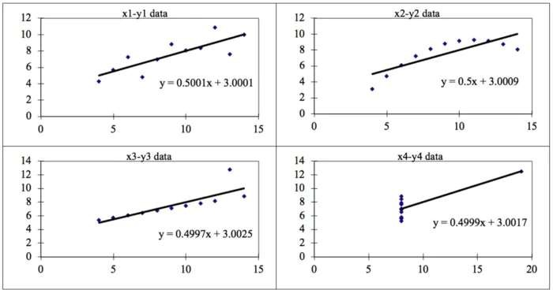
2. Explain Anscombe's quartet in detail.
Ans. Anscombe's quartet has 4 datasets that have nearly identical statistical properties which when graphed appears completely different from each other . The datasets contain 11 x and y values .They were constructed in 1973 by the statistician Francis Anscombe to demonstrate both the importance of graphing data before analyzing it and the effect of outliers on statistical properties. by doing so , the statisticians used this and founf the mean , std deviation and correlation between x and y.

Slide 8
The first scatter plot (top left) appears to be a simple linear relationship.
The second graph (top right) is not distributed normally; while there is a relation between them , it’s not
linear.
In the third graph (bottom left), the distribution is linear, but should have a different regression line
the fourth graph (bottom right) shows an example when one high-leverage point is enough to produce a high correlation coefficient, even though the other data points do not indicate any relationship between the variables.

Slide 9
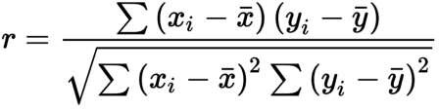
3. What is Pearson’s R?
Ans. Pearson's R is a measure of linear correlation between two sets of data. It is the covariance of two variables, divided by the product of their standard deviations; thus it is essentially a normalised measurement of the covariance, such that the result always has a value between −1 and 1.
r = 1 means the data is perfectly linear with a positive slope ( i.e., both variables tend to change in the same direction)
r = -1 means the data is perfectly linear with a negative slope ( i.e., both variables tend to change in different directions)
r = 0 means there is no linear association
r > 0 < 5 means there is a weak association
r > 5 < 8 means there is a moderate association
r > 8 means there is a strong association
it is given by equation

Slide 10
4. What is scaling? Why is scaling performed? What is the difference between normalized scaling and standardized scaling?
Ans. It is a step of data Pre-Processing which is applied to independent variables to normalize the data within a particular range. It also helps in speeding up the calculations in an algorithm.
If scaling is not done then the algorithms only takes it magnitude into account and not its units leading to
incorrect modelling , hence scaling is used
Normalization is a scaling technique in which values are shifted and rescaled so that they end up ranging between 0 and 1. It is also known as Min-Max scaling.
Standardization is another scaling technique where the values are centered around the mean with a unit standard deviation. This means that the mean of the attribute becomes zero and the resultant distribution has a unit standard deviation.

Slide 11
5. You might have observed that sometimes the value of VIF is infinite. Why does this happen?
VIF - the variance inflation factor -The VIF gives how much the variance of the coefficient estimate is being inflated by collinearity.(VIF) =1/(1-R_1^2 ). If there is perfect correlation, then VIF = infinity . Where R-1 is the R-square value of that independent variable which we want to check how well this independent variable is explained well by other independent variables- If that independent variable can be explained perfectly by other independent variables, then it will have perfect correlation and it’s R-squared value will be equal to 1.So, VIF = 1/(1-1) which gives VIF = 1/0 which results in “infinity”

Slide 12
6. What is a Q-Q plot? Explain the use and importance of a Q-Q plot in linear regression.
A q-q plot is a plot of the quantiles of the first data set against the quantiles of the second data set . It is used to compare the shapes of distributions . A Q-Q plot is a scatterplot created by plotting two sets of quantiles against one another. If both sets of quantiles came from the same distribution, we should see the points forming a line that’s roughly straight. The q-q plot is used to check if:
two data sets have a common distribution
two data sets have common location and scale
two data sets have similar distribution
two data sets have similar tail behavior

